Slide 1
Using Hidden Markov Model to create EDM Music
By Alexander Ho

Slide 2
Agenda
Goal/Motivation
What is a Hidden Markov Model? (HMM)
Coding Process
Music Feature Analysis
Clustering Extracted Features into states
Outputs
Next Steps

Slide 3
Goal/Motivation
Goal:
The goal of this project was to create a simple EDM song based off sample music
Motivation:
HMM can learn the statistical patterns such as the rhythms of drum beats, the frequencies and lengths of different notes, and chord progressions. These patterns can then be used to generate new music

Slide 4
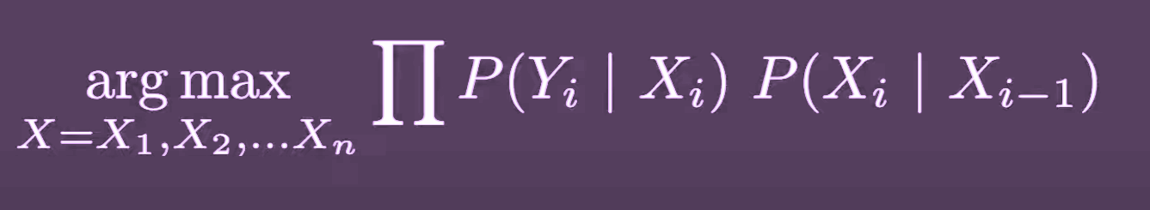
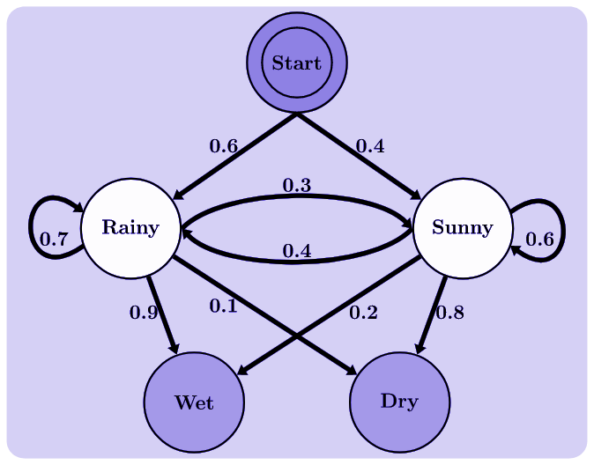
What is a Hidden Markov Model (HMM)?
HMM is a sequential decision making model
What makes it hidden?
A set of hidden states
A set of observable states
A set of probabilities that describe the transitions between hidden states and the generation of observable states
The key assumption is that the current state is only dependent on the previous state, and not on any previous states before that, which makes it a Markov chain

Slide 5
Music Feature Analysis
1

Slide 6
Coding Process Overview
Preprocess the Data: Extract relevant features from the music data, such as pitch, duration, and velocity of each note
Train the HMM: Learn patterns in the data and develop a probabilistic understanding of what notes should follow one another.
Generate New Music: Generate new music by feeding it a sequence of notes and sampling from the probabilities at each time step to generate new notes.

Slide 7
Preprocess the Data
1
Preprocesses audio files by extracting the pitch, duration, and velocity of each note.
Concatenates the note sequences into a matrix, where each row corresponds to a single note and the columns represent the pitch, duration, and velocity of that note.
Use the matrix as input to train an HMM for generating new music.

Slide 8
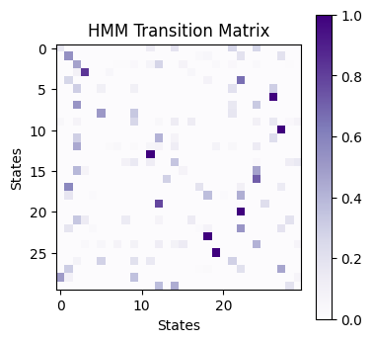
Training the HMM
2
The model is trained on the note sequences extracted from the preprocessed audio files.
The transition matrix represents the probabilities of transitioning from one state to another.
The means and covariances of each state represent the characteristic features of the notes assigned to that state
By sampling from the probability distributions represented by the model, we can generate new music
Number of States = 30. Capture 30 different patterns or clusters of notes in the training data.

Slide 9
The HMM Model
2
GaussianHMM
Assumes that the emission probabilities are normally distributed continuous variables
Feature vectors used are continuous variables
MultinomialHMM
Assumes that the emission probabilities are discrete probabilities over a finite set of symbols
If the feature vectors were discrete values or probabilities over a finite set of symbols, then this would be a more appropriate choice

Slide 10
Generate New Music:
3
Generate each note in the sequence by sampling from the HMM
Get the probabilities of transitioning to each state from the current state
Calculate the probabilities of each pitch value at the current state
Sample a new pitch and duration from their respective probabilities
Choose a new state based on the transition probabilities
Add the new note to the sequence

Slide 11
State Clustering
2

Slide 12
Coding Process Overview
Cluster States: Cluster extracted audio features into states (using k-means)
Convert beat frames to a sequence: Convert to a sequence of fixed time steps and assign a state to each time step based on its corresponding feature vector
Train an HMM: Based on the sequence of states from step 2
Generate a new sequence: New sequences of states by sampling from the probability distribution over states at each time step, given the previous state and the observed beat frame
Map the generated sequence: Map states back to audio features using the centroids of the clusters used in step 1
Generate new music: Synthesize new audio from the generated features

Slide 13
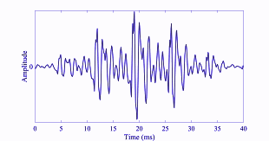
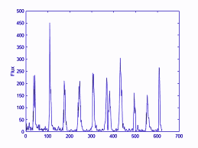
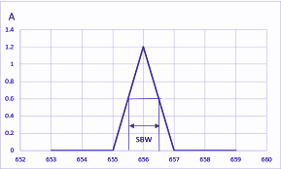
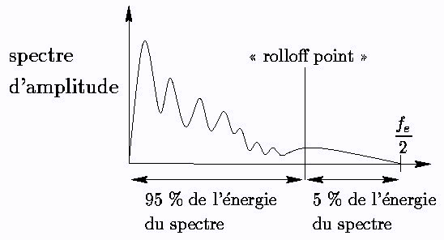
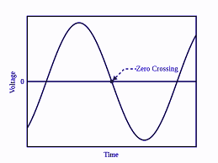
State Cluster States
MFCC
1
Flux
Mel-frequency cepstral coefficients (MFCC) - Extracts information about the sound's frequency content.
Chroma - The musical notes being played
Spectral flux - Changes in the sound's energy over time
Spectral bandwidth - How wide the frequency range of the sound is
Spectral rolloff - The frequency at which the majority of the sound's energy is concentrated below
Zero-crossing rate - How often the sound wave changes direction (+ -)
Bandwidth
Rolloff
Zero Cross

Slide 14
Convert Beat Frames to a Sequence:
1&2
Break songs into smaller chunks called beats.
Analyze the MFCC Features into groups using KMeans
Allows us identify different sections of the song based on their rhythmic patterns, such as the intro, verse, chorus, drop, and outro
Convert beat frames into a sequence of discrete fixed time steps
Assign each time step a state based on the closest cluster center.
This allows for analysis of the audio signal over time and enables the identification of patterns and features within the signal

Slide 15
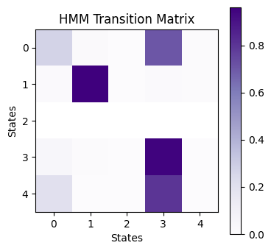
Training an HMM
3
Transition matrix: Probability of moving from one state to another in a sequence. We compute this matrix based on the states.
Starting state: The state from which we begin the sequence. We set the probability of starting with the first state to 1.
Emission probabilities: Each state has a probability distribution over the observed data. We compute the probability of observing each cluster given the state.
Number of States = 5

Slide 16
Generate New Sequences
4
Use the trained HMM to generate a new sequence of states
Viterbi algorithm: An algorithm that finds the most likely sequence of hidden states given the observed sequence. We use it to generate the sequence of states.
The resulting sequence of states and corresponding beat frames can be used to generate a new song with similar characteristics to the original training data.

Slide 17
Mapping Generated Sequences
5
Map the generated sequence of states back to audio features using the centroids of the clusters.
For each state in the generated sequence, the corresponding centroid of the cluster is retrieved and added to a list of features.
The resulting list of features is then stacked vertically to create a feature matrix for the entire song.

Slide 18

Generating New Music
6
Using inverse MFCC transformation we can synthesize new music by converting the generated audio features back into a time-domain audio signal.
This is a type of spectral synthesis where the spectral content of the original audio is used to create new audio with similar spectral characteristics.

Slide 19
Next Steps
Create a dataset with more songs
Experiment with different HMM architectures
using more complex emission distributions
incorporating additional features
Use different synthesis techniques
Use techniques from music theory to inform the model design and evaluate its output from a musical perspective

Slide 20
Thank you!

